Slide 1
Capstone Project
Bank Marketing
Ajith Priyantha- DSA_0364

Slide 2
Problem
The data is related with direct marketing campaigns of a Portuguese banking institution.
The marketing campaigns were based on phone calls. Often, more than one contact to the same client was required
The classification goal is to predict if the client will subscribe a term deposit (variable y) or not.
This problem was addressed as a binary classification problem.
UCI repository link is given below.
https://archive.ics.uci.edu/ml/datasets/Bank+Marketing

Slide 3
Methodology
Load Data to the Colab environment
'https://raw.githubusercontent.com/ajithdolamulla/Capstone-Project/main/bank-full.csv'
Inspecting loaded Dataset Ex. data.info(),data.shape,data.describe(include='all').transpose(),data['y'].unique() etc.
Pre-Process Data for Training
Transform into Binary Column – ex. data['y_act']=np.where(data['y'] == 'no',0,1) ,
Create ID Column – ex. data['id'] = data.index+1
Rearranging Columns
Descriptive stats and identify Ranges – ex. data[‘ ’].describe function
Outlier treatment and Plot distributions – ex. data['age'].plot(kind='box') , find Outliers using Percentiles.
working on categorical columns – ex. One hot encoding (1/0, create dummy variables)
Label Encoding (ordinal) for education categorical column

Slide 4
Methodology
Data Pre-processing Function – Pre-process the input parameters and select features for the ML model
Train Test Split – train_test_split function in Scikit-learn
Manually explore hyperparameter space- Random Forrest and Logistic Regression algorithm
Use of Grid Search – GridSearchCV in Scikit-learn
Select Best Model – select the best model considering accuracy, precision, F1Score, roc_auc
Saving Best Model – using pickle or joblib
Score Function - model.predict_proba(input_data)
Post-processing Function for Prediction
Prediction Function for Application (Inference Pipeline) – Test with sample data
Feature Importance using LIME and SHAP models to explain the feature importance

Slide 5
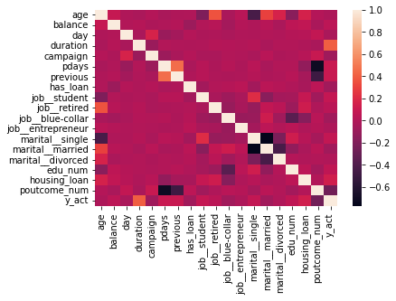
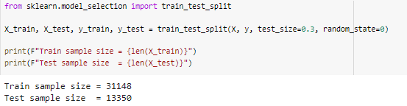
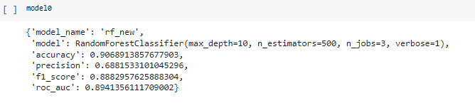
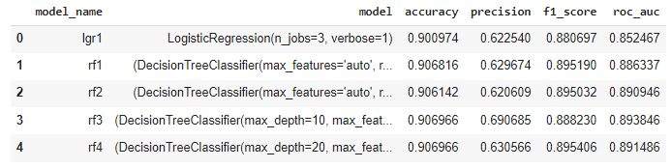
Results

Slide 6
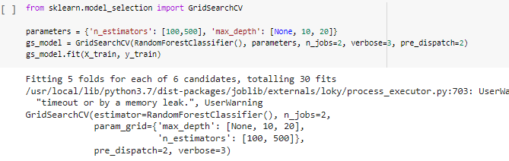

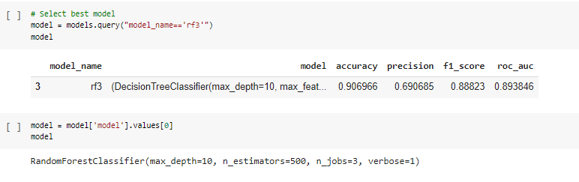
Results

Slide 7
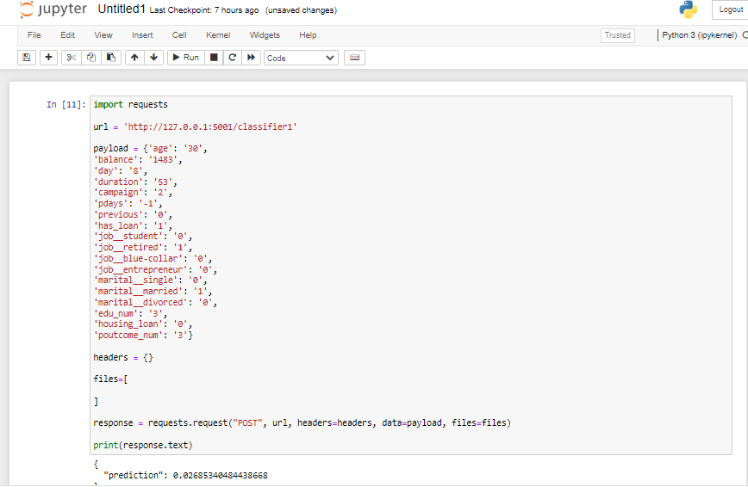
Application Deployment
Locally hosted Web API – using jupyter notebook

Slide 8
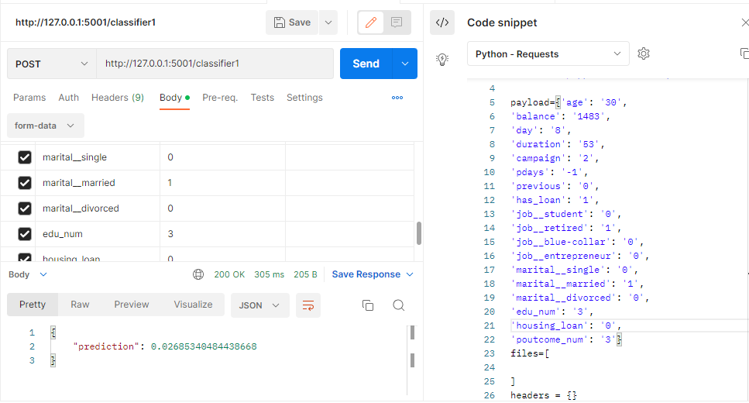
Using _POSTman tool

Slide 9
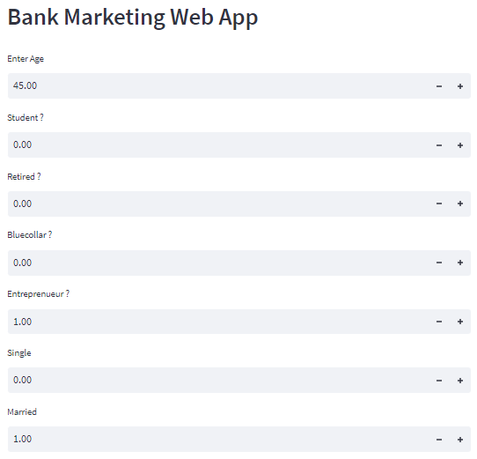
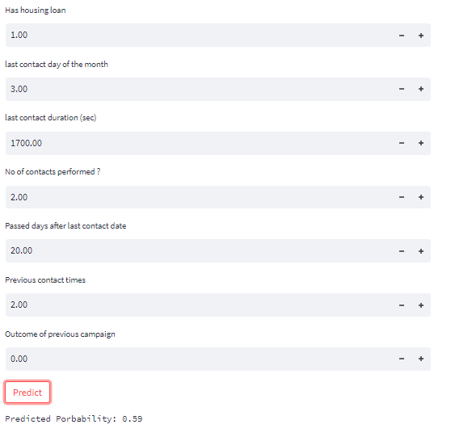
Application development Using Streamlit

Slide 10
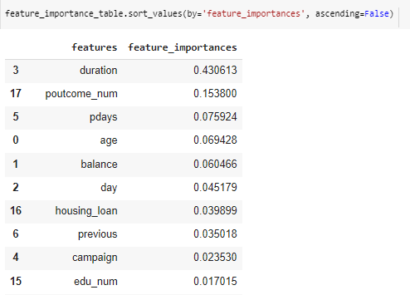
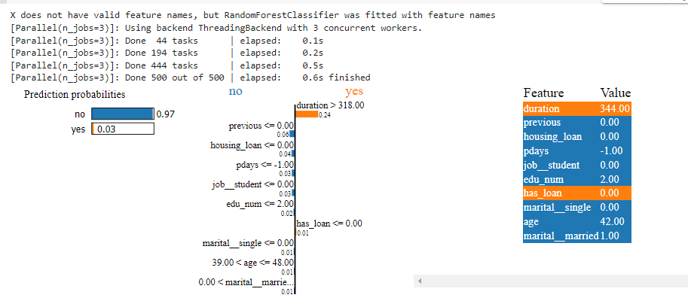
Feature importance
LIME model

Slide 11
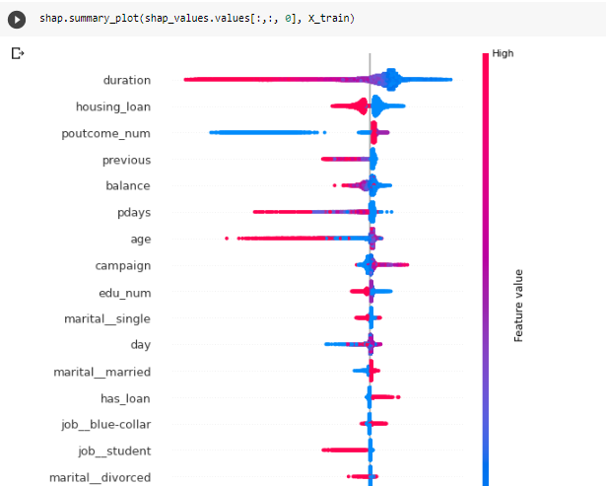
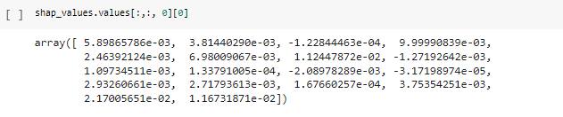
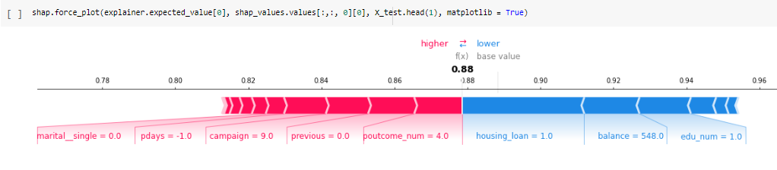
Feature importance
SHAP model

